Slide 1
Advanced Processor Architecture
Lecture 05
Instruction Set
Processor Structure
Instructor: Tapushe Rabaya Toma
Lecturer, SWE, DIU

Slide 2
Reference Books
Computer Organization and Architecture: Designing for Performance- William Stallings (8th Edition)
Any later edition is fine

Slide 3
Addressing Techniques
Depends on trade-off between address range and/or addressing flexibility, and the number of memory references in the instruction and/or the complexity of address calculation
Immediate
Direct
Indirect
Register
Register indirect
Displacement
Stack

Slide 4
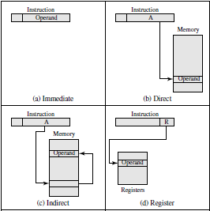
Addressing Techniques

Slide 5
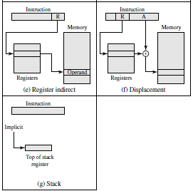
Addressing Techniques

Slide 6
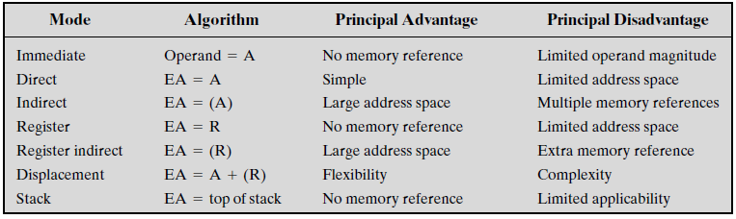
Addressing Techniques

Slide 7
Addressing Techniques
Virtually all computer architectures provide more than one of these addressing modes
Often, different opcodes will use different addressing modes
Also, one or more bits in the instruction format can be used as a mode field
Effective address (EA): In a system without virtual memory, the effective address will be either a main memory address or a register
In a virtual memory system, the effective address is a virtual address or a register
The actual mapping to a physical address is a function of the memory management unit (MMU) and is invisible to the programmer

Slide 8
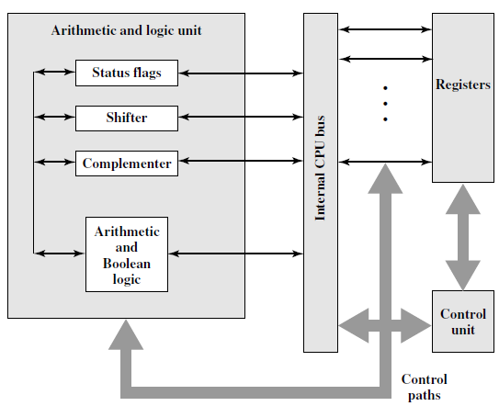
Internal Structure of the CPU

Slide 9
Register Organization
The registers in the processor perform two roles:
User-visible registers: Enable the machine-or assembly language programmer to minimize main memory references by optimizing use of registers
Control and status registers: Used by the control unit to control the operation of the processor and by privileged, operating system programs to control the execution of programs

Slide 10
User-Visible Registers
Could be categorized into following categories:
General purpose
Data
Address
Condition codes
GP registers can be assigned to a variety of functions by the programmer
Any general-purpose register can contain the operand for any opcode
Can be used for addressing functions (e.g., register indirect, displacement)

Slide 11
User-Visible Registers
Data registers may be used only to hold data and cannot be employed in the calculation of an operand address
Address registers may themselves be somewhat general purpose, or they may be devoted to a particular addressing mode
Such as:
Segment pointers: Holds the address of the base of the segment.
Index registers: These are used for indexed addressing and may be auto indexed
Stack pointer: If there is user-visible stack addressing, then typically there is a dedicated register that points to the top of the stack
This allows implicit addressing; that is, push, pop, and other stack instructions need not contain an explicit stack operand

Slide 12
User-Visible Registers
A partially visible registers, which hold condition codes (also referred to as flags)
Condition codes are bits set by the processor hardware as the result of operations
Example: An arithmetic operation may produce a positive, negative, zero, or overflow result
In addition to the result itself being stored in a register or memory, a condition code is also set
The code may subsequently be tested as part of a conditional branch operation

Slide 13
Control and Status Registers
Four main categories:
Program counter (PC): Contains the address of an instruction to be fetched
Instruction register (IR): Contains the instruction most recently fetched
Memory address register (MAR): Contains the address of a location in memory
Memory buffer register (MBR): Contains a word of data to be written to memory or the word most recently read

Slide 14
Control and Status Registers
Program Status Word (PSW)
Contains condition codes plus other status information. Common fields or flags include the following:
Sign: Contains the sign bit of the result of the last arithmetic operation
Zero: Set when the result is 0
Carry: Set if an operation resulted in a carry (addition) into or borrow (subtraction) out of a high-order bit
Equal: Set if a logical compare result is equality
Overflow: Used to indicate arithmetic overflow
Interrupt Enable/Disable: Used to enable or disable interrupts
Supervisor: Indicates whether the processor is executing in supervisor or user mode

Slide 15
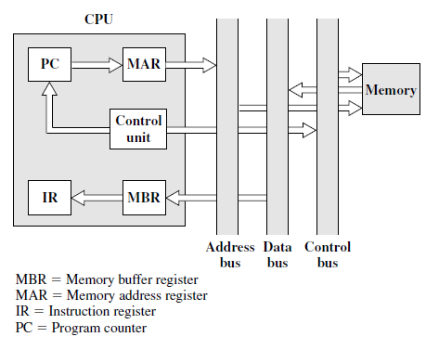
Data Flow
Figure: Data Flow, Fetch Cycle

Slide 16
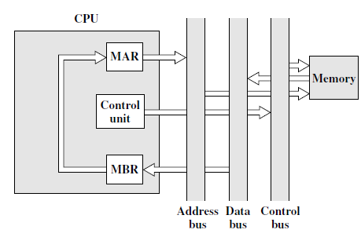
Data Flow
Figure: Data Flow, Indirect Cycle

Slide 17
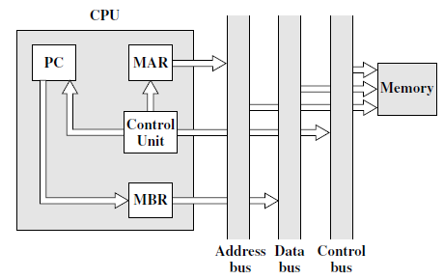
Data Flow
Figure: Data Flow, Interrupt Cycle

Slide 18
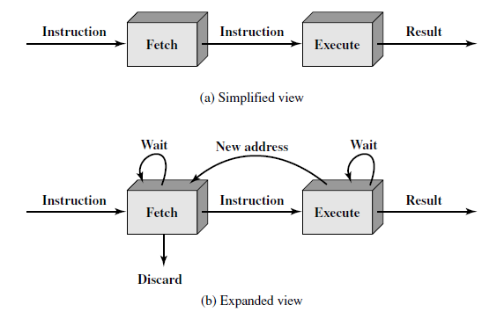
Instruction Pipelining
Similar to the use of an assembly line in a manufacturing plant
An instruction has a number of stages
Figure: Two-Stage Instruction Pipeline

Slide 19
Instruction Pipelining
This pipeline has two independent stages
The first stage fetches an instruction and buffers it
When the second stage is free, the first stage passes it the buffered instruction
While the second stage is executing the instruction, the first stage takes advantage of any unused memory cycles to fetch and buffer the next instruction
This is called instruction prefetch or fetch overlap

Slide 20
Instruction Pipelining
Speed-up is unlikely for two reasons:
The execution time will generally be longer than the fetch time
Fetch stage may have to wait for some time before it can empty its buffer
A conditional branch instruction makes the address of the next instruction to be fetched unknown
Fetch stage must wait until it receives the next instruction address from the execute stage
The execute stage may then have to wait while the next instruction is fetched

Slide 21
Instruction Pipelining
Solution for problem 2:
Guessing can reduce the time loss.
When a conditional branch instruction is passed on from the fetch to the execute stage, the fetch stage fetches the next instruction in memory after the branch instruction
Then, if the branch is not taken, no time is lost
If the branch is taken, the fetched instruction must be discarded and a new instruction fetched

Slide 22
Instruction Pipelining
Stages of instruction processing
Fetch instruction (FI): Read the next expected instruction into a buffer
Decode instruction (DI): Determine the opcode and the operand specifiers
Calculate operands (CO): Calculate the effective address of each source operand. This may involve displacement, register indirect, indirect, or other forms of address calculation
Fetch operands (FO): Fetch each operand from memory. Operands in registers need not be fetched
Execute instruction (EI): Perform the indicated operation and store the result,if any, in the specified destination operand location
Write operand (WO): Store the result in memory

Slide 23
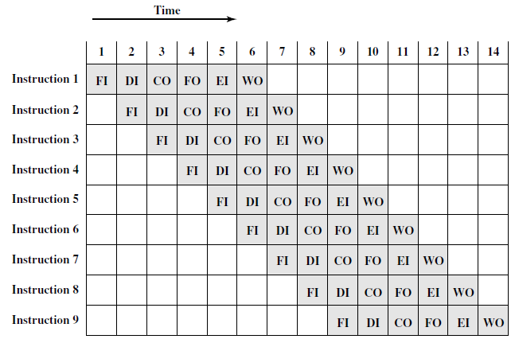
Instruction Pipelining

Slide 24
Instruction Pipelining
Several other factors limit the performance
If the six stages are not of equal duration, there will be some waiting involved at various pipeline stages
Another difficulty is the conditional branch instruction, which can invalidate several instruction fetches

Slide 25
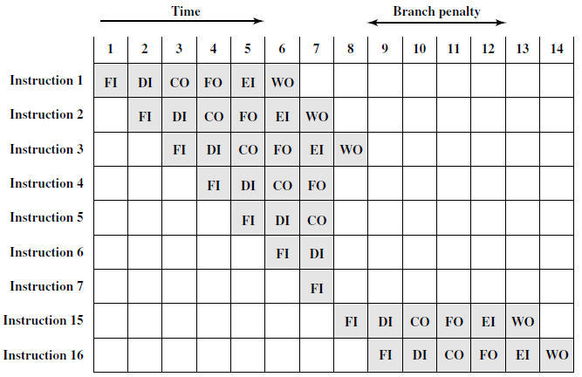
Instruction Pipelining

Slide 26
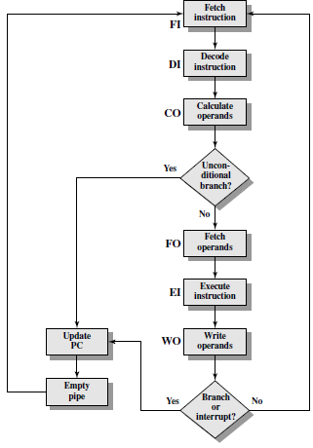
Instruction Pipelining
Flowchart:
Six-Stage CPU Instruction Pipeline

Slide 27
Instruction Pipelining
Though it might appear that the greater the number of stages in the pipeline, the faster the execution rate
At each stage of the pipeline, there is some overhead involved in moving data from buffer to buffer and in performing various preparation and delivery functions
This overhead can appreciably lengthen the total execution time of a single instruction
This is significant when sequential instructions are logically dependent, either through heavy use of branching or through memory access dependencies
The amount of control logic required to handle memory and register dependencies and to optimize the use of the pipeline increases enormously with the number of stages
Another consideration is latching delay: It takes time for pipeline buffers to operate and this adds to instruction cycle time

Slide 28
Pipeline Hazards
A pipeline hazard occurs when the pipeline, or some portion of the pipeline, must stall because conditions do not permit continued execution
Referred to as also a pipeline bubble
There are three types of hazards:
Resource
Data and
Control

Slide 29
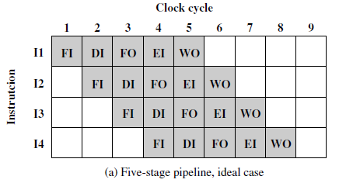
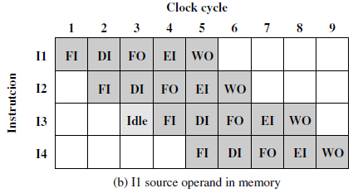
Pipeline Hazards
Resource Hazards: A resource hazard occurs when two (or more) instructions that are already in the pipeline need the same resource
The result is that the instructions must be executed in serial rather than parallel for a portion of the pipeline
Sometime referred to as a structural hazard

Slide 30
Pipeline Hazards
What happens when multiple instructions are ready to enter the execute instruction phase and there is a single ALU?
Read the book!

Slide 31
Pipeline Hazards
Data Hazards: Occurs when there is a conflict in the access of an operand location
Two instructions in a program are to be executed in sequence and both access a particular memory or register operand
If the two instructions are executed in strict sequence, no problem occurs
However, if the instructions are executed in a pipeline, then it is possible for the operand value to be updated in such a way as to produce a different result than would occur with strict sequential execution
In other words, the program produces an incorrect result because of the use of pipelining

Slide 32
Pipeline Hazards
Three types of data hazards
Read after write (RAW), or true dependency: An instruction modifies a register or memory location and a succeeding instruction reads the data in that memory or register location
A hazard occurs if the read takes place before the write operation is complete
Write after read (WAR), or anti-dependency: An instruction reads a register or memory location and a succeeding instruction writes to the location
A hazard occurs if the write operation completes before the read operation takes place
Write after write (WAW), or output dependency: Two instructions both write to the same location
A hazard occurs if the write operations take place in the reverse order of the intended sequence

Slide 33
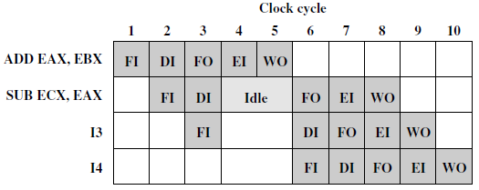
RAW Data Hazard

Slide 34
Pipeline Hazards
Control Hazards: Also known as a branch hazard, occurs when the pipeline makes the wrong decision on a branch prediction and therefore brings instructions into the pipeline that must subsequently be discarded

Slide 35
Thank you!

